Slide 1

Clinical Trials Supplies Modeling
  Presenter: Christi Kleoudis, AstraZeneca
  Subteam Members:
  Fei Chen, J&J
  Cunyi Wang, J&J
  Guohui Wu, Regeneron
  CG Wang, Regeneron
  Vlad Anisimov, Amgen
  Kaifeng Lu, Beonemed
  Allison Gray, J&J

Slide 2

Christi Kleoudis, AstraZeneca
Efficiency+ Scientific Working Group
Senior Director of Biostatistics
Supporting regulatory submissions in GI, HIV, and autoimmune diseases for 40 years
Driving process change to accelerate submissions while maintaining study integrity and quality
Providing key support to RTSM functionality
Leading the Clinical Trials Supplies workstream

Slide 3

Beyond Drug Minimization
  Not just about drug minimization
  Model drug waste, drug & shipping costs, and stockout probability based on weighted importance
  Modules to model
    Manufacturing & labeling
    Flow to drug depots
    Flow to sites
  Design aspects to consider
    Stratified, adaptive, multiple doses, titration, enrollment caps

Slide 4
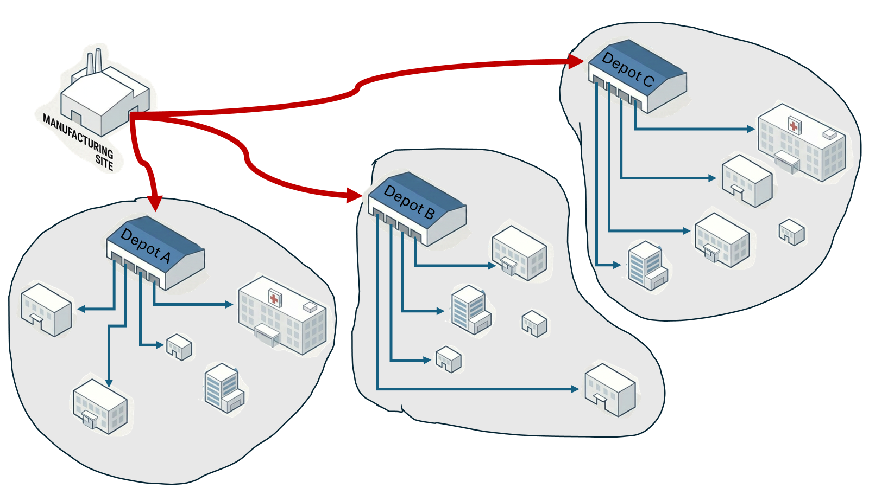
Modules
  Manufacturing & labeling
    Batch quantity manufactured
    # Depots
    Languages
    Shelf Life
  Drug depots
    Customs lead time
    Countries/languages covered
    Shelf-life requirements
    Regional recruitment projections
  Sites
    Shipment lead time
    Site recruitment projections
    Proportion randomized to each treatment
    Withdrawal rate

Slide 5
Process
Capture specifications for logistics and assumptions
Determine how to weight importance of optimizing drug wastage, costs, and stock out
Use AI to create a simulation plan
Conduct interactive simulations until all modules are complete
Perform sensitivity analyses to check simulation logic
Model against the outcomes: drug wastage, stock out
Verify code generated by AI

Slide 6
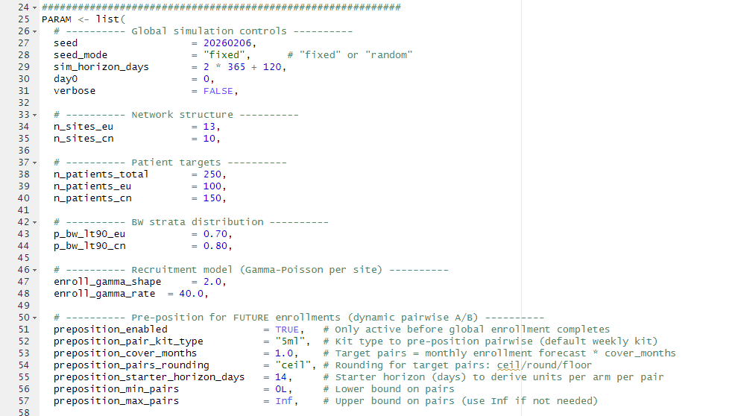
AI-generated Simulation Code Generated from Trial Specifications

Slide 7
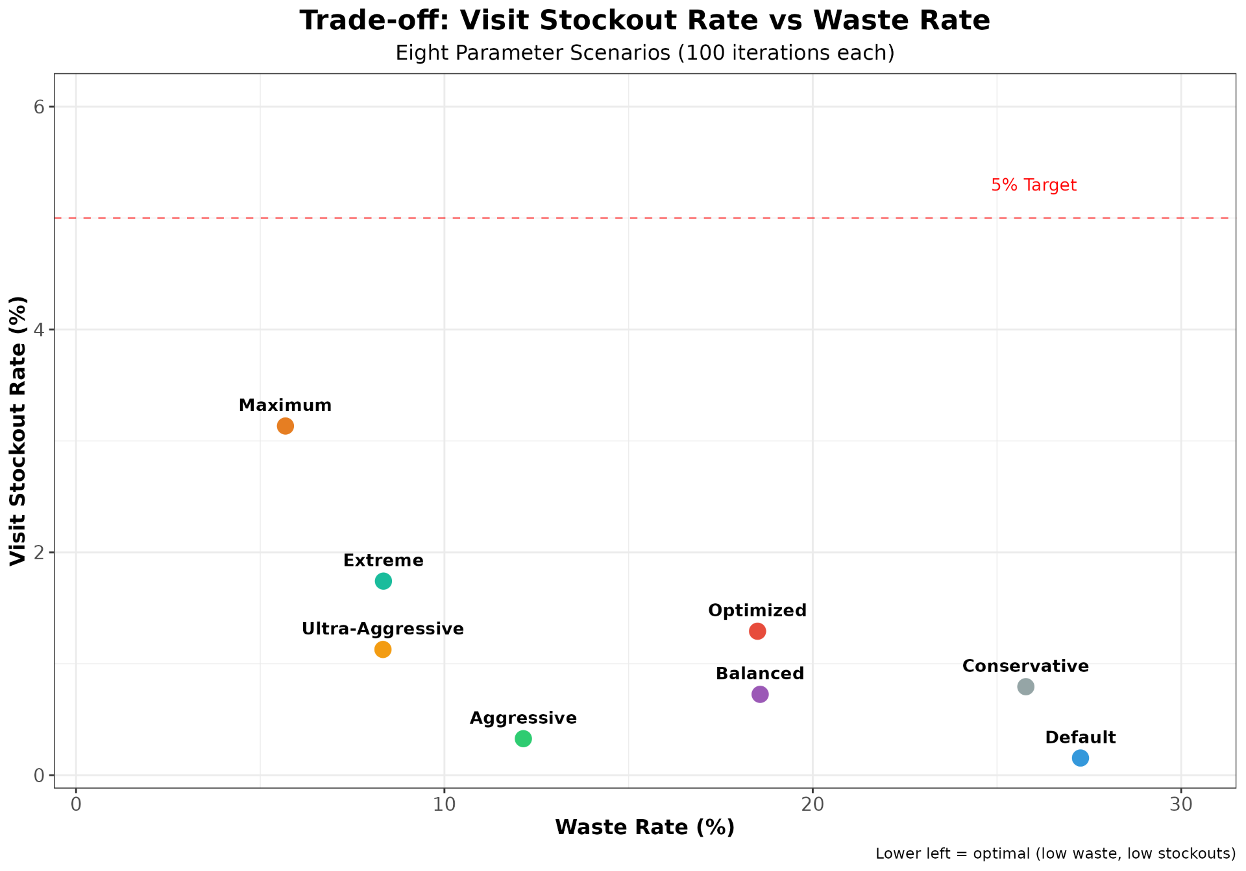

Slide 8


Next Steps
Short term
Add Costs to model
Verify manufacturing, depot, and site modules from simulation plan
Test against multiple designs
Generate simulation code automatically from specification
Long term
Dynamic modeling using real enrollment data to update drug flow throughout the study

Slide 9












Depot C
Depot B
Depot A

